Slide 1
Shoebox Appeal 2022

Slide 2
“People say ‘it’s just a shoebox’ but it isn’t. It tells that child someone, somewhere, has done this for them; that someone cares about them.”
Dave Cooke, Founder

Slide 3
Intro…

Slide 4
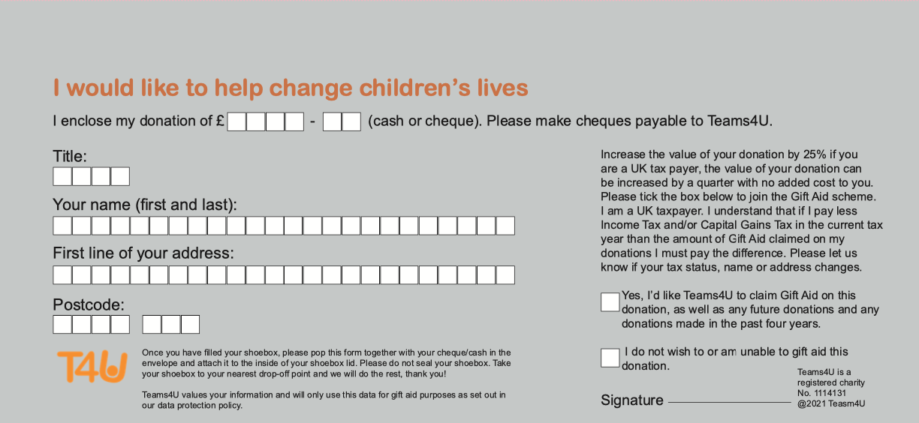
What to do:
Step 1: Find an empty shoebox or go to the T4U website and
order a flatpack shoebox.
Step 2: Choose who you’d like your shoebox to go to, and stick the label to the front of your shoebox.
Step 1: Personalise your shoebox. Take a look at our gift ideas, but please don’t include
anything from the NO list.
Step 4: Please complete the attached form and enclose it in an envelope with the recommended donation of £3.00 and place on top of the gifts before closing the lid.
Step 5: Please secure your shoebox with an
elastic band and drop off at your local drop off point.

Slide 5
What to include:
Please choose a selection of items from the suggested lists opposite - this is not meant to be an exhaustive list (more ideas are available on our website) but please do not include anything from the 'NO' list.
Please visit our YouTube channel (@teams4Utube) to watch videos of example shoeboxes being made.
Toothbrush & toothpaste
Hair accessories/brush
Soap & face cloth
Stationery & paper
Gloves
Hat & scarf
New socks/underwear
A soft toy
A small game
Puzzle
Small musical instruments
Toy vehicle
Small rubber ball/inflatable ball
Sweets (use by date from March)
A photo of yourself
Candles
Cooking utensils (no knives)
Plastic containers
T-towels (preferably decorative)
Hairbrush
Small toiletries/ soap
Plastic utensils
Bowls & cups
Small Christmas decoration
Small decorative item
Washing up cloths
Clothes pegs
Headscarves
New socks/underwear
Jewellery
Make-up
Food (only exception is sweets)
Medicines
Military themed items (such as toy soldiers/tanks/ guns)
Aerosols or anything highly flammable
Sharp items
Novels
Please ensure all items are in good condition and undamaged. All shoeboxes are checked and we reserve the right to remove any unsuitable items. Sometimes we may have to change a shoebox to meet our packaging requirements.

Slide 6
Gift Aid:
Please complete and print the attached form and enclose it in an envelope with the recommended donation of £3.00 and place on top of the gifts before closing the lid.

Slide 7
Shoebox Labels:
Choose who you’d like your shoebox to go to, and fill out the label. Please stick to the front of your shoebox lid. Additional labels can be downloaded from our website if needed.

Slide 8
Contact Us:
Website: www.teams4u.com
Phone: 01978 310110

Slide 9
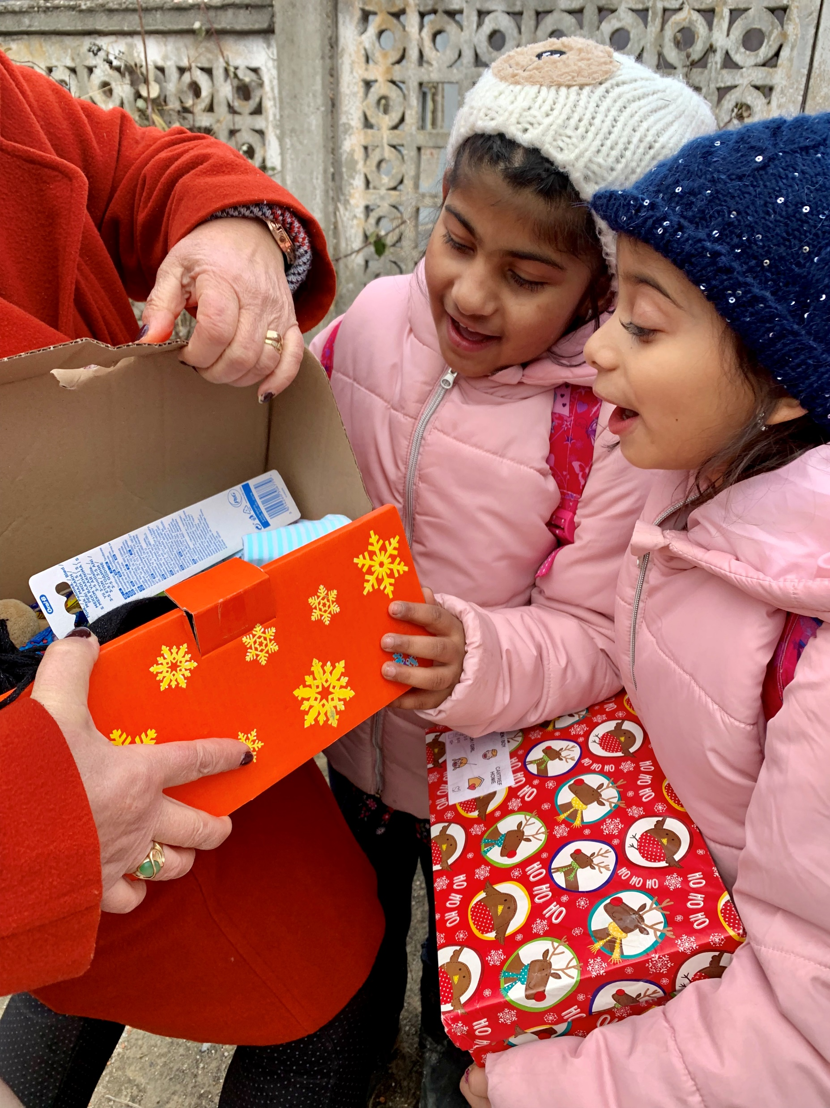
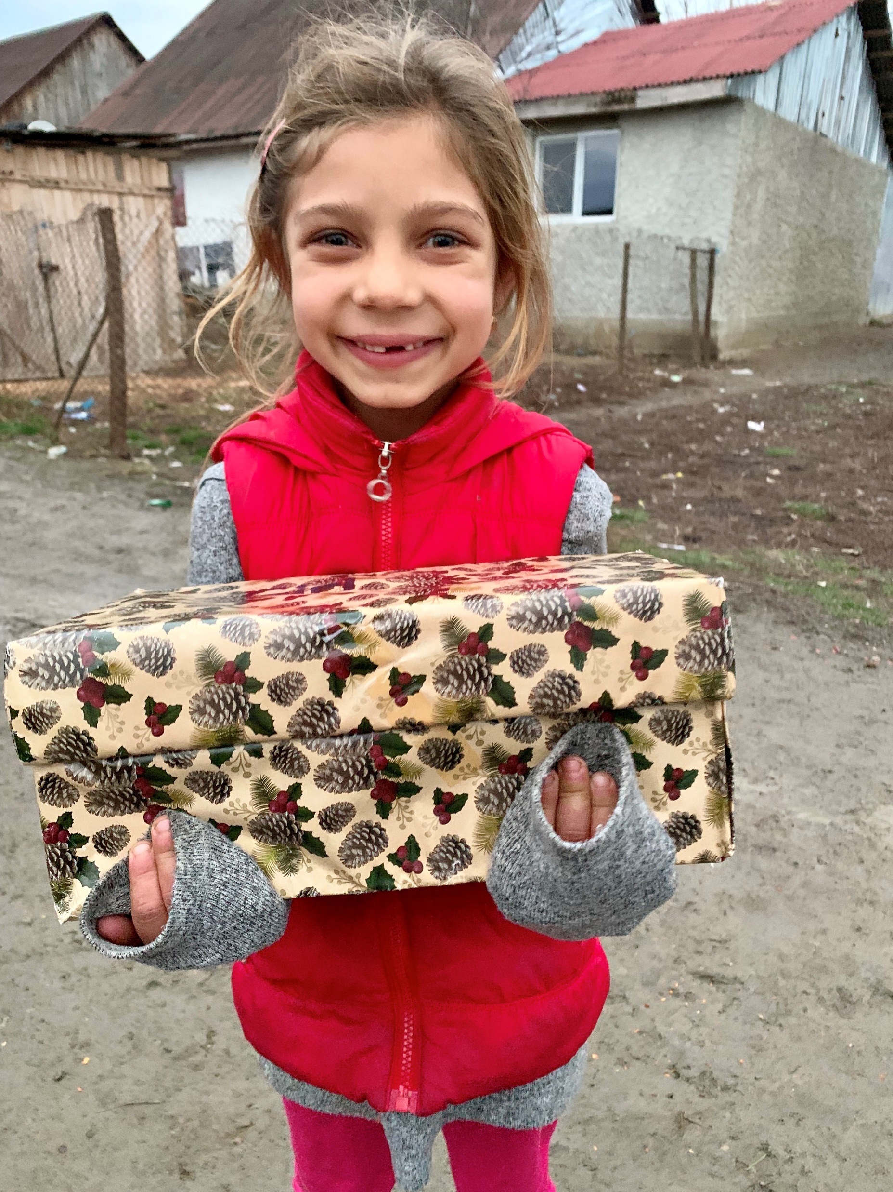
THANK YOU!

